Slide 1
Eden Plant Density Update
S.F. Jones 05.25.2022

Slide 2
Seasons combined- not strong patterns across seasons in perennial pickleweed
Points = mean (n=3 transects) +/- standard error (st. dev / sqrt(3))

Slide 3
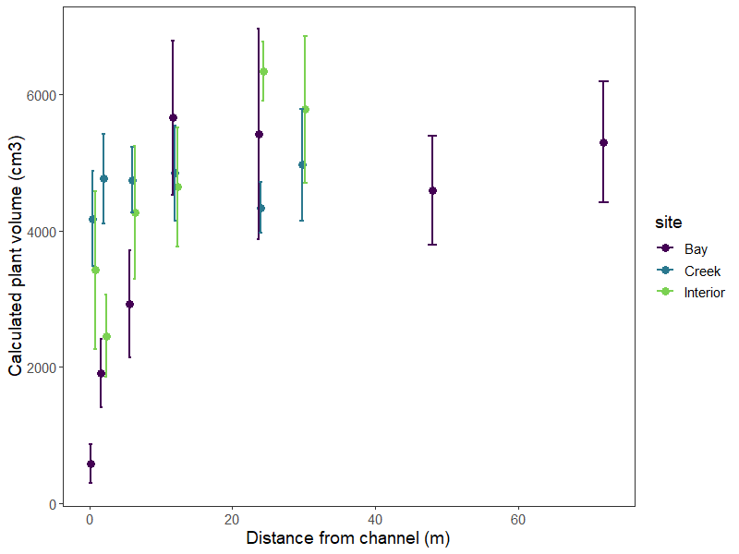
Calculated volume

Slide 4
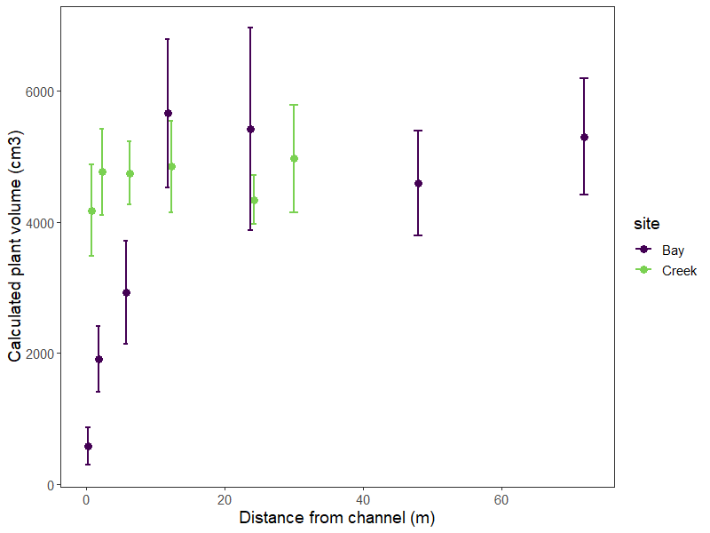
Calculated volume

Slide 5
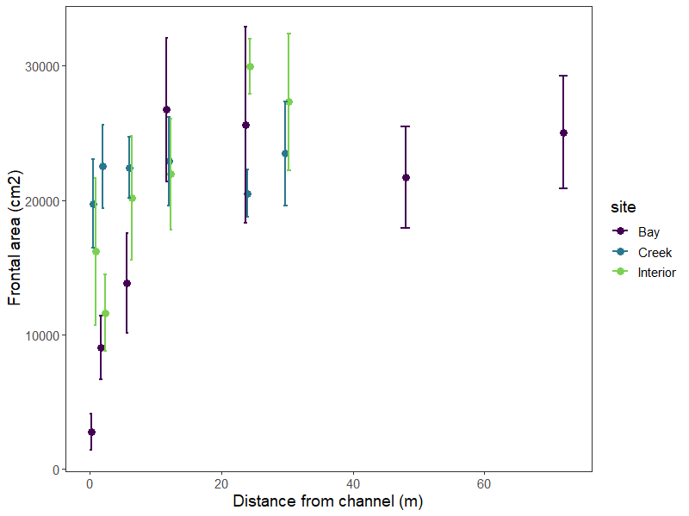
Frontal area

Slide 6
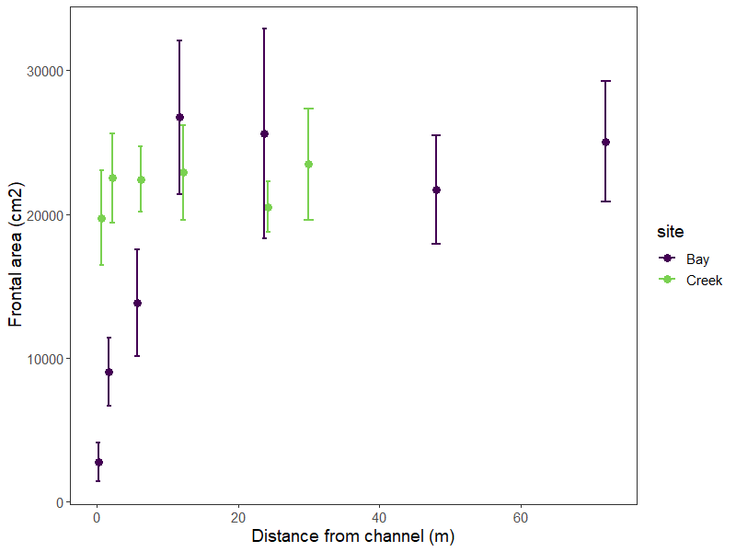
Frontal area

Slide 7
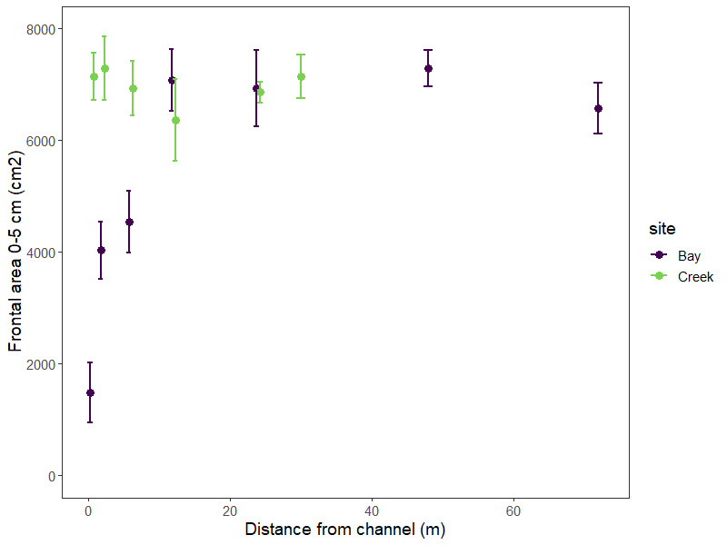
Frontal area 0-5 cm

Slide 8
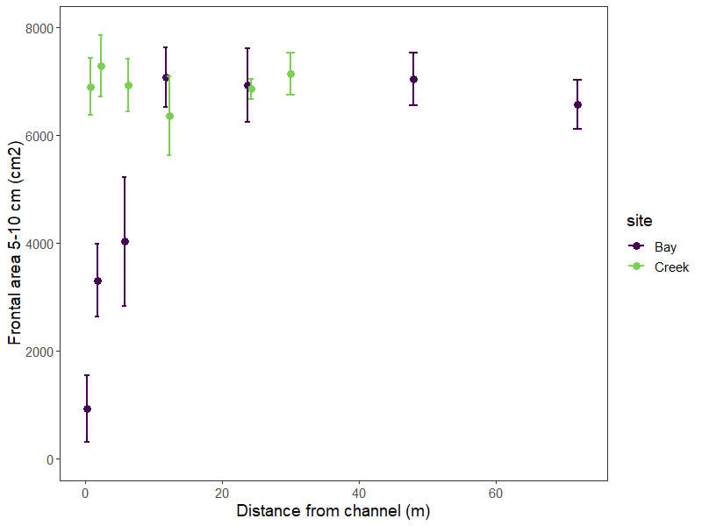
Frontal area 5-10 cm

Slide 9
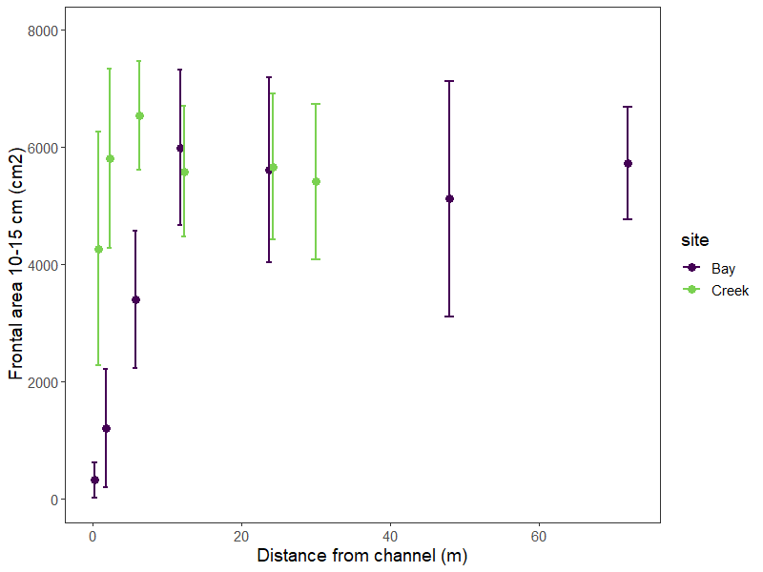
Frontal area 10-15 cm

Slide 10
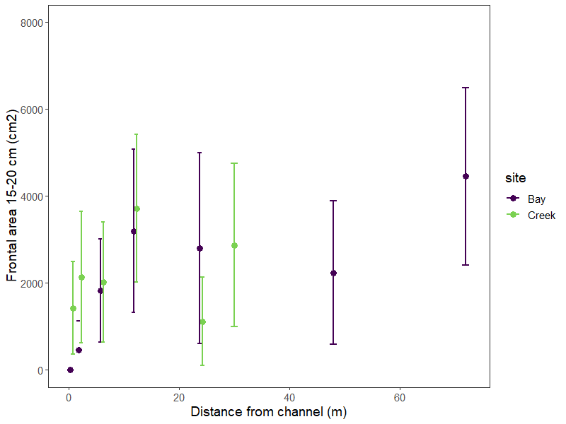
Frontal area 15-20 cm

Slide 11
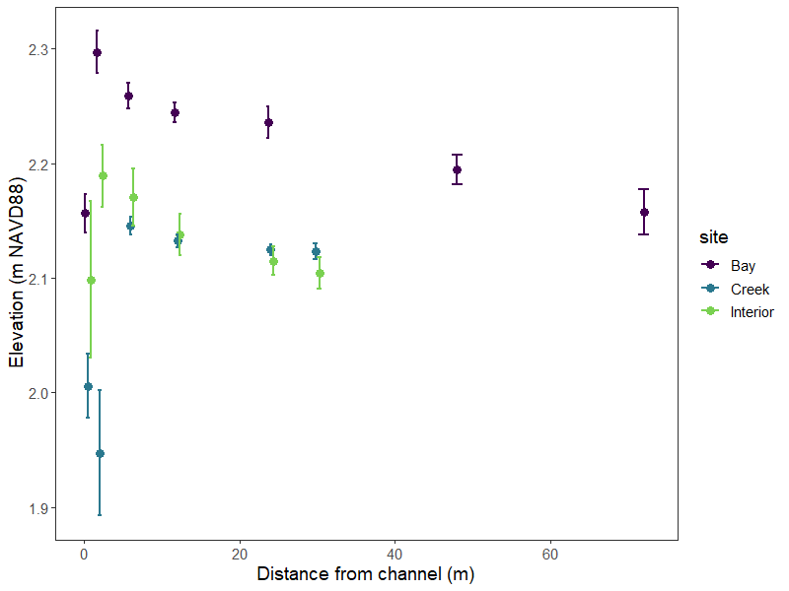
Elevation NAVD88

Slide 12
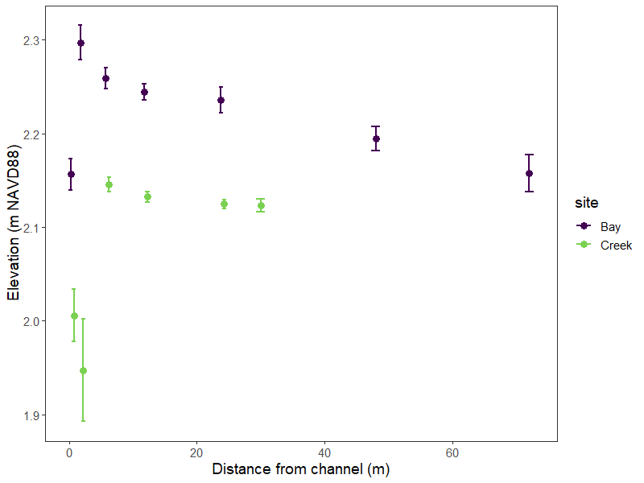
Elevation NAVD88

Slide 13
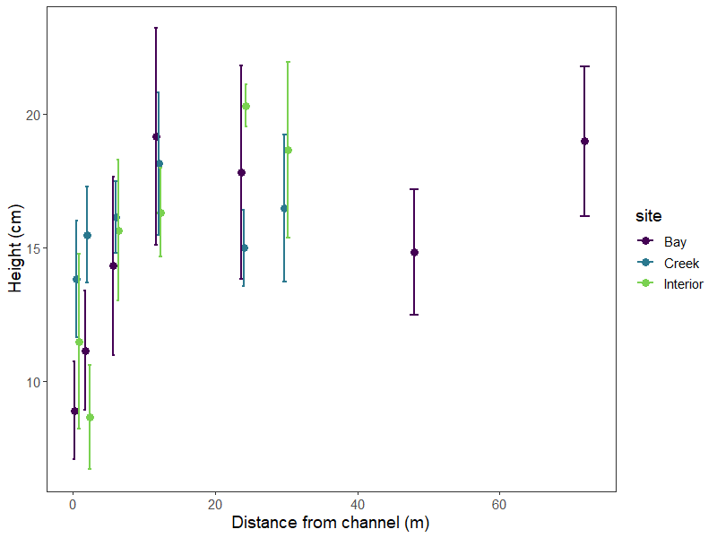
Ave height

Slide 14
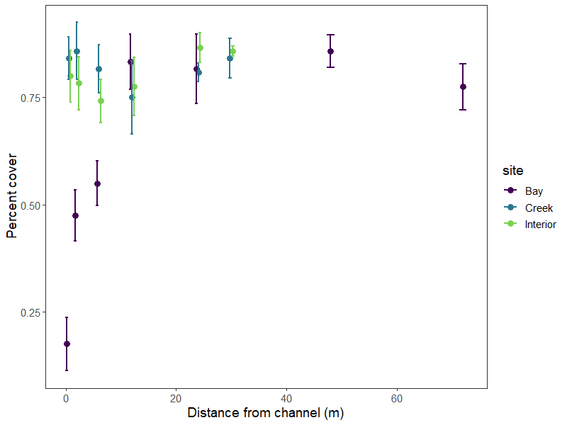
% Cover

